Slide 1
System Analysis and Design
Eighth Edition
Alan Dennis, Barbara Wixom, Roberta M. Roth
Appendix 5A
Normalizing the Data Model

Slide 2
Normalization
Technique used to validate data models
Series of rules applied to logical data model to improve its organization
Three normalization rules are common
First normal form (1NF)
Second normal form (2NF)
Third normal form (3NF)

Slide 3
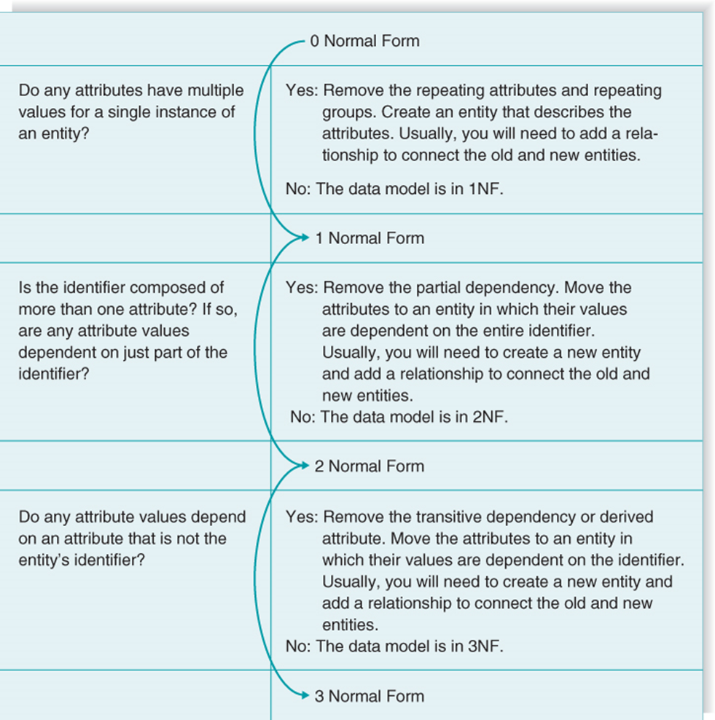
Summary of Normalization Steps

Slide 4
First Normal Form
A logical data model is in first normal form (1NF) if it does not contain attributes that have repeating values for a single instance of an entity
Often, this problem is called repeating attributes, or repeating attribute groups

Slide 5
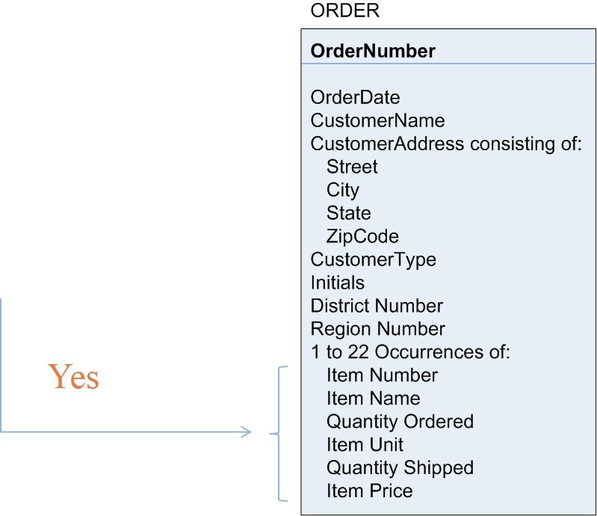
Example: Unnormalized Entity
Begin with an entity from the logical data model
Do any attributes (or groups of attributes) occur more than once for a single occurrence of the entity?
Yes

Slide 6
Example: First Normal Form
Do any attributes (or groups of attributes) occur more than once for a single occurrence of the entity?
If yes, move the attributes (or groups) into separate entities

Slide 7
Potential Anomalies with First Normal Form
Insert anomaly:
Insert a new Item?
Can not do without Order Number
Deletion anomaly:
Assume only one order for Item #456
What happens if order is cancelled?
Will lose all information about Item #456
Update anomaly:
The price of Item # 789 changes
What problem occurs?
Need to search entire database for all occurrences of Item # 789

Slide 8
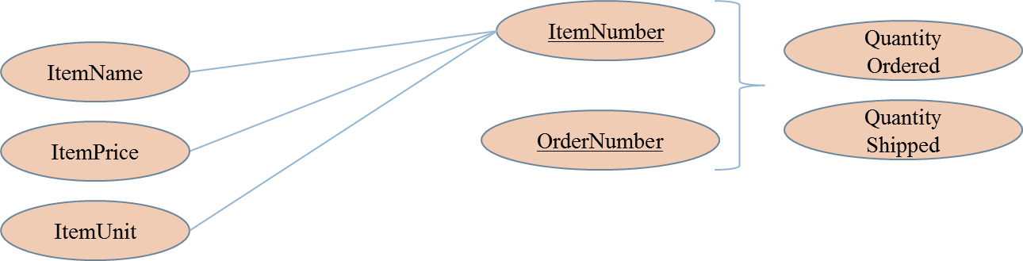
Reason Anomalies Exist
Several non-key attributes depend only on ItemNumber
Should depend on the full primary key (ItemNumber + OrderNumber)

Slide 9
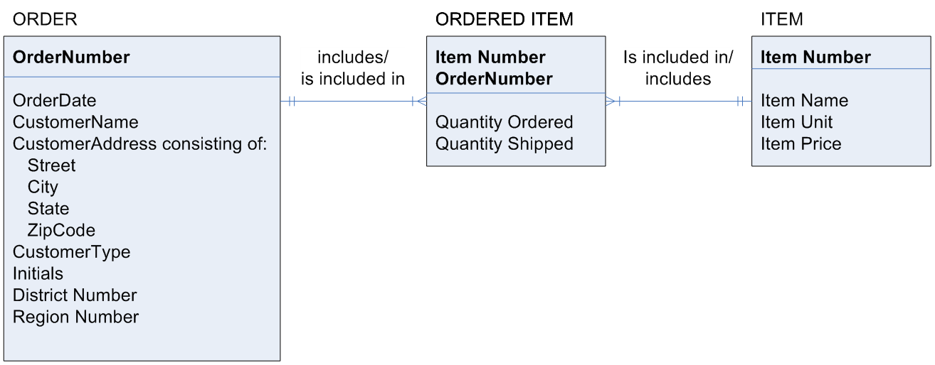
Example: Second Normal Form
For entities with concatenated keys…
Do any attributes depend on just part of the key rather than the entire key?
If yes, move partially-dependent attributes to a new entity…

Slide 10
Potential Anomalies with Second Normal Form
The ORDER entity contains transitive dependencies
Several non-key attributes depend on another non-key attribute, and NOT on the Primary Key
CustomerAddress, CustomerType, DistrictNumber, and RegionNumber depend on the CustomerName, NOT the OrderNumber
Solution: remove these attributes to a separate entity

Slide 11
Example: Third Normal Form
Do any attribute values depend on an attribute that is not the entity’s key?
If yes, move these attributes to a new entity

Slide 12
Summary of Normalization Steps

